Slide 1
CS 2200
Lab 5

Slide 2
Announcements
Exam 1 was today 😁😁😁
Project 1 demo slots are open!
Remember, this is a multiplier of your project grade.
Mandatory
Project 2 is out and will be due Feb 26th @ 11:59 PM
HW 4 releasing today i think

Slide 3




Today’s Topic:
C, and GDB

Slide 4
C and GDB
*Here is a good external resource for learning C.

Slide 5
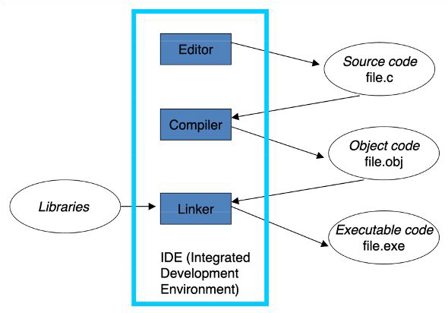
Writing and Compiling
Compiler analyzes the source ﬁle and converts it into machine language which creates an executable ﬁle.
Most commonly used compiler is gcc!
What does the following command do?
gcc -o program program.c
What happens when we need to link executables together?
We’ll use a Makefile to make life easier.

Slide 6
Writing and Compiling
gcc -o program program.c
Writes build into named output file
Makefile
Builds & compiles program
Checks dependencies
Determines if recompilation is necessary
Other commands such as clean, debug, etc.

Slide 7
Questions: Preprocessor Directives
What does #include do?
What does #define do?
What is an example use of #define?

Slide 8
Answer: Preprocessor Directives
#include: Allows you to include other system ﬁles or local ﬁles
<stdio.h> - System ﬁles
“utils.h” - Local ﬁles
#define: Used to deﬁne macros. After the macro is deﬁned, the compiler can substitute the token string for each occurrence of the identiﬁer in the source ﬁle. You use this syntax when creating constants that represent numbers, strings, or expressions.
#define pi 3.14
#define multiply(a,b) (a * b)

Slide 9
Questions: Datatypes and Structs
C is strictly typed and compiled. What does this mean?
What built-in C function can we use to find the number of bytes of a data type?
What is a struct?
How do we access members of a struct?
What does an arrow operator (->) do when accessing a member of a struct?

Slide 10
Answer (Part 1): Datatypes
C is strictly typed and compiled
Data types for variables must be deﬁned by the user and put together at compile time
Some common C data types include: char, short, int, ﬂoat, long, double
We use the sizeof() function to compute the number of bytes a data type occupies in the computer’s memory.

Slide 11
Answer (Part 2): Structs
C also contains structs
Groupings of several diﬀerent variables used for easier parsing of complex data structures.
Individual components of a struct can be accessed with the dot operator
Example: int a = s.data
The -> operator is used to de-reference a struct and access its member at the same time!

Slide 12
Accessing members of a struct
typedef struct s
{
char c;
int x;
int* pointer;
} s_t;
s_t my_struct; // Declare struct
my_struct.c = 'a'; // Set c to “a”
my_struct.x = 5; // Set x to 5
int temp = 20; // Create a new int
s_t.pointer = &temp; // Set pointer to address of int

Slide 13
Pointers
Refers to a location in memory
Pointers are deﬁned using the asterisk *.
int *a_ptr; is a pointer to an int
Also, use an asterisk to dereference a pointer (ﬁnd the value at that address).
int b = *b_ptr;
Use & to get the address of a variable.
int *c_ptr = &c;
Careful with pointer arithmetic! When you add a value to a pointer, you will increase the address by value * sizeof(datatype)
uint32_t *t_ptr = 0x300;
t_ptr + 1 -> 0x304

Slide 14
Pointers
What are the data types of a, a_ptr, b, and b_ptr?
int a, b;
int* a_ptr, b_ptr;

Slide 15
Pointers
What are the data types of a, a_ptr, b, and b_ptr?
int a, b;
int* a_ptr, b_ptr;
Equivalent to:
int a;
int b;
int* a_ptr; === int *a_ptr;
int b_ptr;

Slide 16
Pointers
What are the data types of a, a_ptr, b, and b_ptr?
int a, b;
int* a_ptr, b_ptr;
Equivalent to:
int a;
int b;
int* a_ptr;
int b_ptr; “b_ptr is an int” (WRONG)
The correct way:
int *a_ptr, *b_ptr; “when b_ptr is dereferenced, it is an int”

Slide 17
Exercise: Pointers
// sizeof(short) == 2
// memory address of x is 0x5000
short x = 5;
short* p = &x;
p = p + 6;
What will p equal after this code runs?

Slide 18
Answer: Pointers
// sizeof(short) == 2
// memory address of x is 0x5000
short x = 5;
short* p = &x;
p = p + 6;
What will p equal after this code runs?
0x500C

Slide 19
Structs and pointers
Sometimes, we hold a pointer to a struct in a variable.
Thus, we hold the memory address of the start of that struct in a variable.
How do we access the struct?
s_t* my_struct = (s_t*) malloc(sizeof(s_t));
malloc returns a void pointer, always need to cast!
my_struct->c = 'a';
(*mystruct).c = 'b';
typedef struct s
{
char c;
int x;
int* pointer;
} s_t;

Slide 20
How do we print in C?
printf("Hello World\n");
\n is newline character
What if we want to print x where int x = 8;?
printf("x is: %d\n", x);

Slide 21
Exercise: Functions
What is the difference between pass by value and pass by reference?
Which of these is C?
How would we write a function to swap in C?

Slide 22
Answer: Functions
C is always PASS BY VALUE, you must manually specify to be pass by reference, by passing in a pointer.
void swap(int *a, int *b) {
int t = *a;
*a = *b;
*b = t;
}
Pointer to functions also exist and you can pass them around!
void (*swap_ptr)(int) = &swap; (*swap_ptr)(a, b);

Slide 23
Memory Allocation
malloc is used to dynamically allocate a single block of memory with the required size from the heap.
mp = (cast_type*) malloc(byte_size);
malloc(): allocates a ﬁxed memory size from the heap and returns a pointer to it.
calloc(): same as malloc but zeros out the memory.
realloc(): takes in some malloced data, allocates some new memory on the heap and copies the data across.
free(): frees some memory pointed to by a pointer.

Slide 24
GDB
Requires the compiler ﬂag -g to make use of GDB eﬀectively.
Here are a few important commands
r runs your program until it hits a breakpoint, segfaults, or terminates.
c continues execution until next bp, segfault, or termination
n goes to next instruction (step-over function calls)
s steps forward (step-into function calls)
b ﬁle.c:n sets a breakpoint at line n in file.c
p var prints the value stored in variable var
x/nfu <memory location> examines a large area of memory.
bt prints a backtrace which allows you to discover the context in which an error was thrown.

Slide 25
Exercise: GDB
Let’s debug the given ﬁle, factorial.c (download Lab 5 folder from Canvas)
#include <stdio.h>
int main()
{
int i, num, j;
printf("Enter the number: ");
scanf("%d", &num);
for (i = 1; i < num; i++) {
j = j * i;
}
printf("The factorial of %d is %d\n", num, j);
}
gcc -g factorial.c
gdb a.out (or lldb a.out)
What can we do to debug?
b 10
r
p i
p j
p num

Slide 26
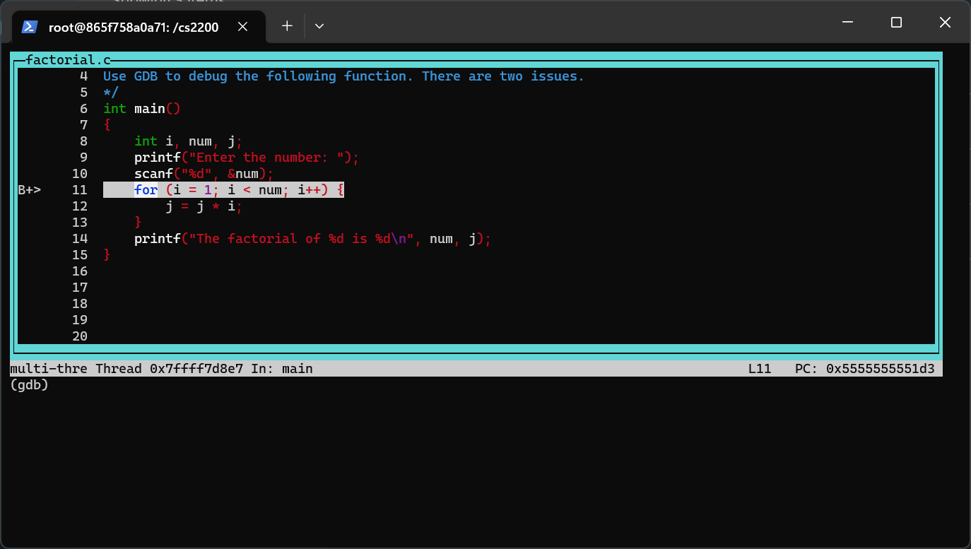
GDB has a TUI 😮
Text User Interface (TUI)
Here’s a good external source that goes over the basics.
Let’s say you’ve set a breakpoint using b and ran the program to that point. Now, type tui enable and we get:

Slide 27
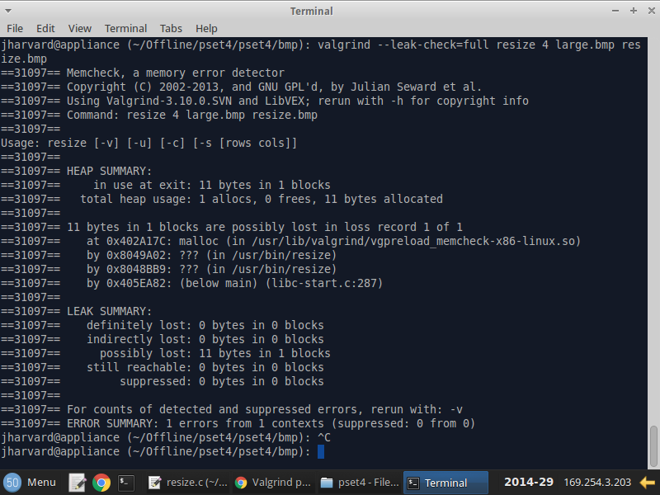
Valgrind: Don’t Leak Memory!
Valgrind is tool to check C/C++ programs for memory leaks
Also has support to detect race conditions and deadlocks with Helgrind
Pay attention to the leak summary at the end!
If compiled with “-g”, provides individual line numbers where memory leaks may be occurring
Install Valgrind in your docker container:
apt install valgrind

Slide 28
Exercise: Valgrind
Let’s debug the given ﬁle with the following header, leaktest.c
#ifndef LEAKTEST_H
#define LEAKTEST_H
void simpleLeak();
void complexLeak();
int freeingIsMyJob();
int* freeingIsYourJob();
typedef struct Node {
int data;
struct Node* next;
} Node;
Node *createNode(int value);
Node *addNode(Node *head, Node *node);
void *deleteNode(Node *head, int value);
#endif
make leaktest
./leaktest
make memtest
View valgrind-out.txt to find the memory leaks!

Slide 29
Thanks for attending!

Slide 30
VSCode Debugging in the Docker Container
Within VSCode, download the Remote Development - Dev Containers extension
Use CTRL/CMD + Shift + P to popup the preferences panel and select “Dev containers: Attach to running container”
Select the cs2200 container (make sure it’s running first!)
Your VSCode will now be tunneled inside your CS2200 container
Download some recommended extensions
C/C++
C/C++ Extension Pack
CMake
CMake Tools
Open the folder you’re working on in VSCode (/cs2200/*)
Set breakpoints wherever you wish
On the left side, click the run/debug tab and click “Run and Debug”
If everything was setup correctly, you should now be debugging your C program!
Notes:
TAs - If you’re comfortable showing students how to debug in VSCode go ahead!

